Slide 1

Hortonworks Data Flow Workshop
Thiago Santiago
Solutions Engineer - LATAM
Notes:
TALK TRACK
Before I wrap up, let me summarize why Hortonworks is better than other Big Data options you might be considering.
[NEXT SLIDE]

Slide 2
Who is here?

Slide 3
Workshop Agenda
Access cluster
Getting started with NiFi
MiNiFi
Kafka Basics
Integrating Kafka with NiFi
Integrating the Schema Registry
Bonus Round : SAM

Slide 4




Workshop Agenda
Today
Bonus
Next
HDF Cluster
Legacy
Nifi
Processor
SAM
SuperSet
Analytics, BI, Ad-hoc Exploration
Meetup RSVP
Complex Event Processing
Kafka
Druid
Visualization & Reporting
Custom Applications
Dashboards
MiNiFi Data
Processor
Schema Registry

Slide 5









Global Data Management With Hortonworks
MODERN DATA USE CASES
EDW OPTIMIZATION
CYBER SECURITY
DATA SCIENCE
ADVANCED ANALYTICS
IOT/ STREAMING ANALYTICS
PARTNER SOLUTIONS
HORTONWORKS CONNECTION
HORTONWORKS PLATFORM SERVICES
EXTENSIBLE SERVICES
ENTERPRISE SUPPORT
PREMIER SUPPORT
EDUCATIONAL SERVICES
PROFESSIONAL SERVICES
COMMUNITY CONNECTION
DATA LIFECYCLE MANAGER
DATA STEWARD
STUDIO*
CLOUD- BREAK*
DATA ANALYTICS STUDIO*
IBM DSX*
ISV SERVICES
OPERATIONAL SERVICES
SMARTSENSE™
DATAPLANE SERVICE (DPS)
MANAGE, GOVERN, SECURE
*not yet available, coming soon
HORTONWORKS DATAFLOW (HDF™)
DATA-IN-MOTION
HORTONWORKS DATA PLATFORM (HDP®)
DATA-AT-REST
CONNECTED DATA PLATFORMS
MULTIPLE CLUSTERS AND SOURCES
HYBRID
MULTI

Slide 6
Hortonworks Data Flow 3.2
NIFI
MiNiFi
SAM
Storm
Kafka
NiFi Registry
Ambari
Zookeeper
Schema Registry
Ranger
Ongoing Innovation in Apache
HDF 3.2
2H2018
1.7.0
0.5.0
0.6.0
1.2.1
1.1.1
0.2.0
2.7.0
3.4.6
0.5.3
1.1.0
HDF 3.1
1H2018
1.2.0
0.2.0
0.5.0
1.1.0
0.10.1.0
0.2.0
2.5.1
3.4.6
0.3.0
0.7.0
HDF 2.1
Aug 2016
1.1.0
1.0.0
1.0.2
0.10.0
2.4.2
3.4.6
0.6.0
HDF 2.0
Mar 2016
1.0.0
0.0.1
1.0.1
0.9.0
2.4.0
3.4.6
0.5.0
HDF 1.2
Oct 2015
0.6.1
0.10.0
HDF 1.0
Dec 2014
HDP 2.2
Dec 2014
0.3.0
STREAMING & INTEGRATION
OPERATIONS
SECURITY
HORTONWORKS DATA FLOW
* HDF 3.0 – Shows current Apache branches being used. Final component version subject to change based on Apache release process.
Notes:
<PRESENTATION>
The newest way that JBoss is delivering Enterprise-class stability and performance is with JBoss Enterprise Platforms.
Having to integrate, and maintain the integrations between the multiple community projects to meet your enterprise middleware platform needs can add complexity and cost to your IT operations. Red Hat solves this problem with JBoss Enterprise Platforms.
JBoss Enterprise Platforms integrate the most popular JBoss.org projects into stable, secure, certified distributions with a single patch and update stream. JBoss Enterprise Platforms are available via subscriptions that include certified software, industry-leading support, updates and patches, documentation and multi-year maintenance policies.
Now, customers can leverage all the innovation, flexibility and value of open source without additional time and expense of maintain their own application platform. Everybody wins.
</PRESENTATION>

Slide 7
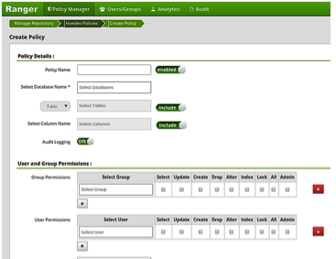
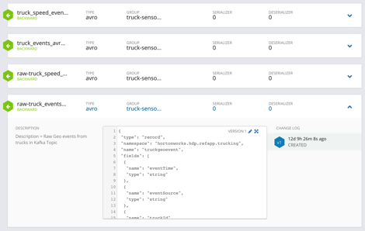
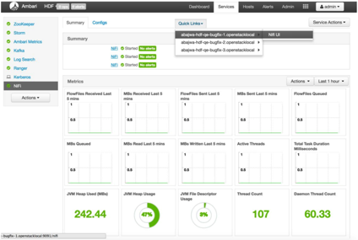
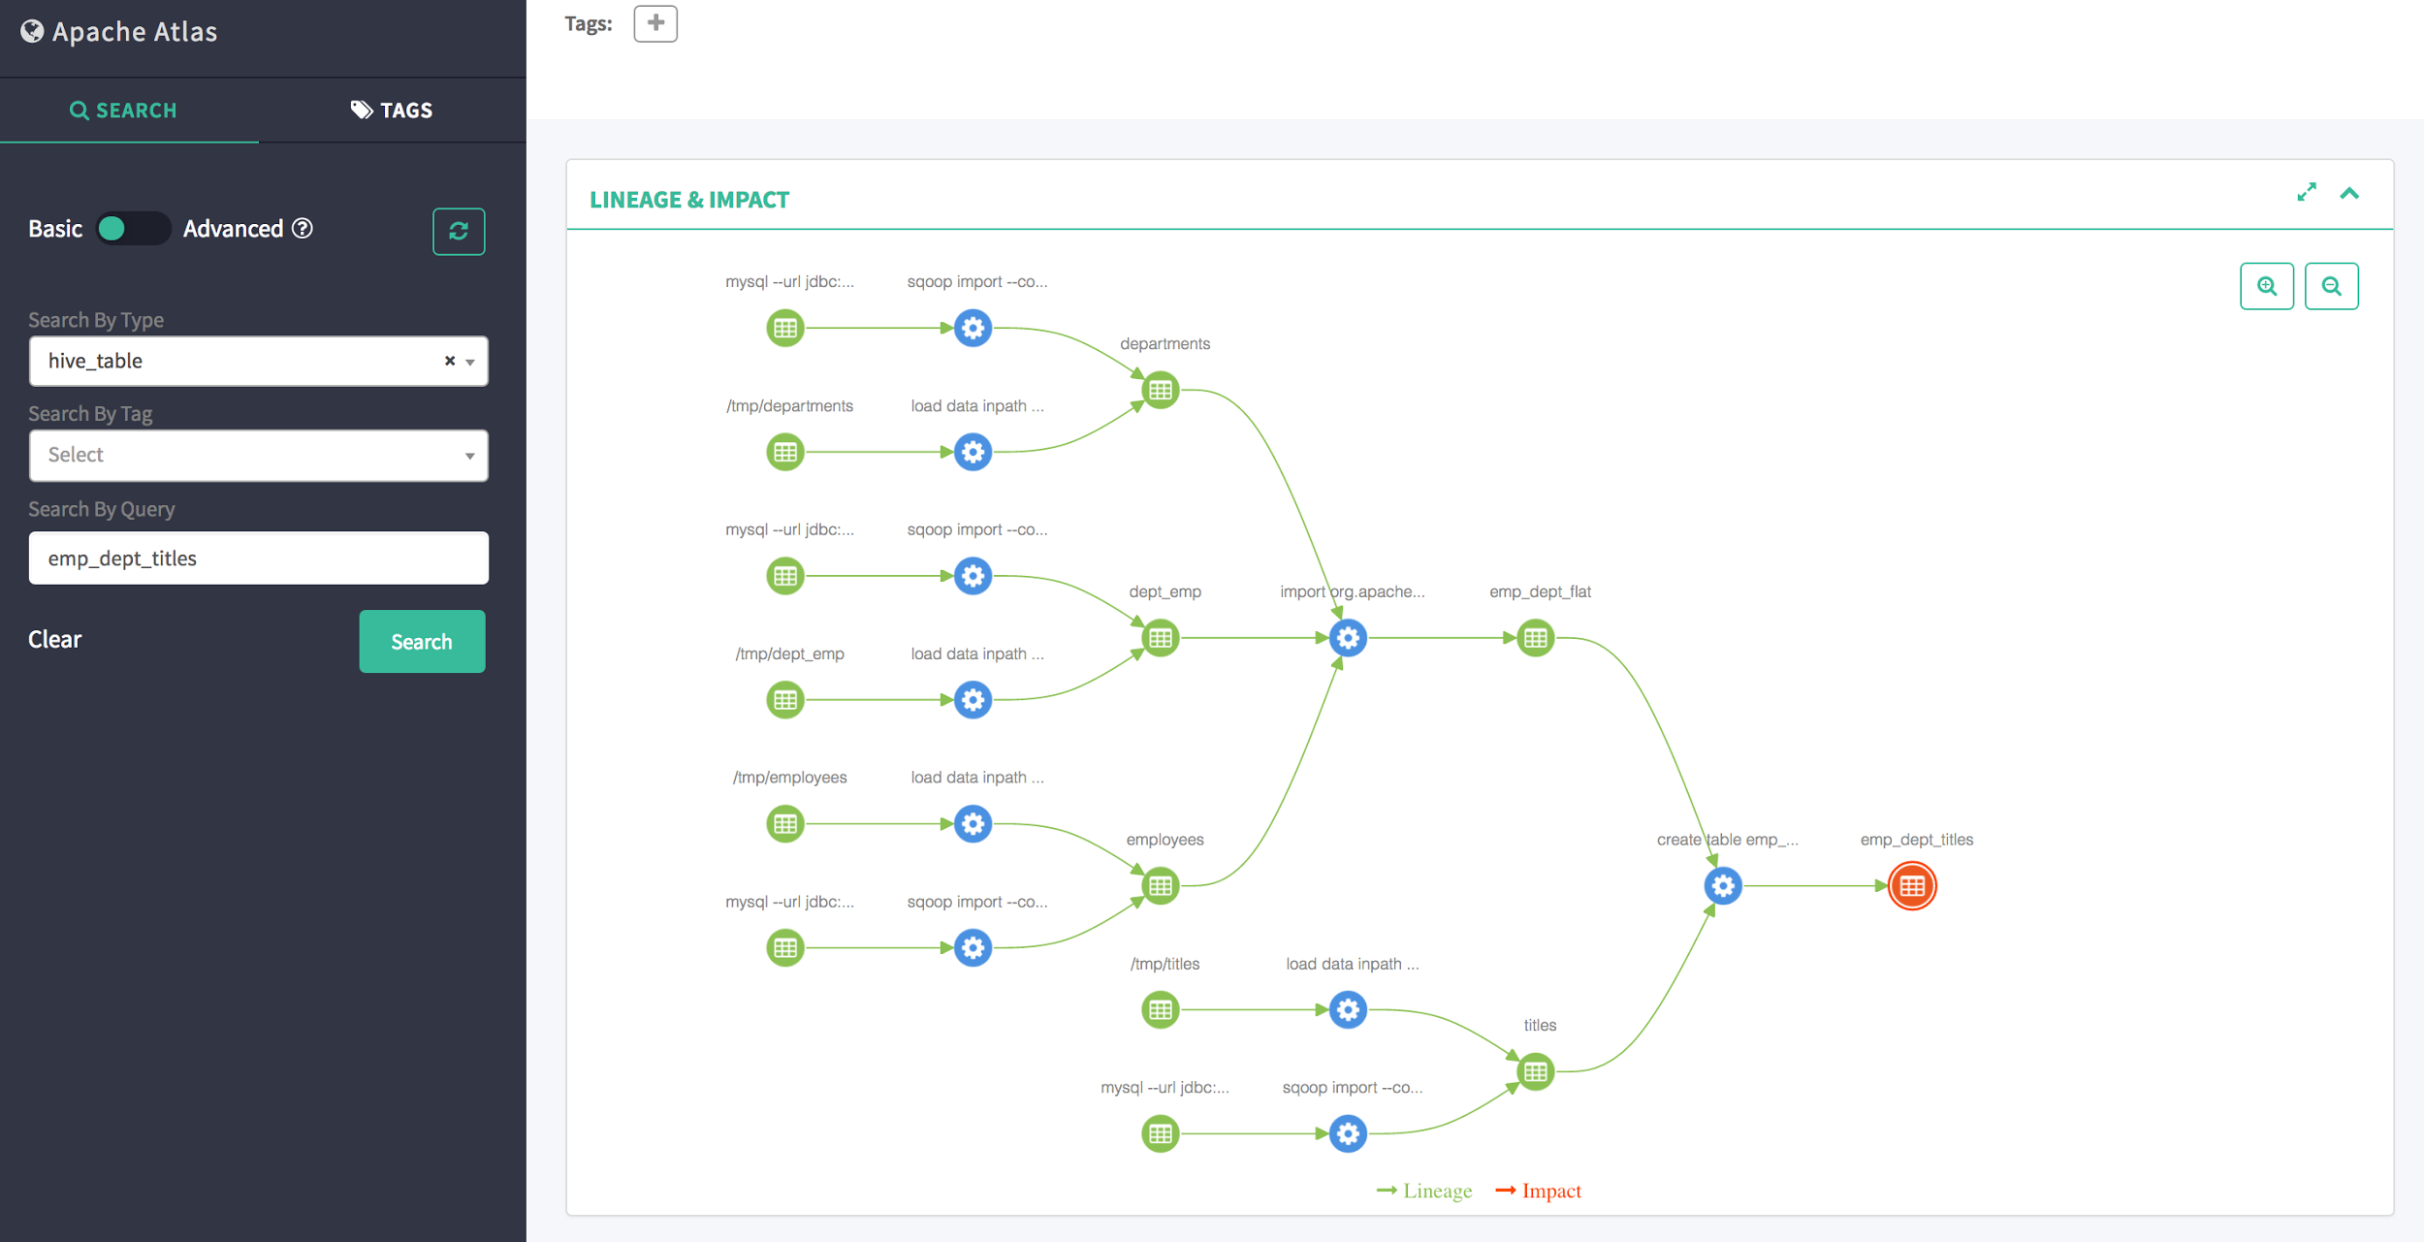
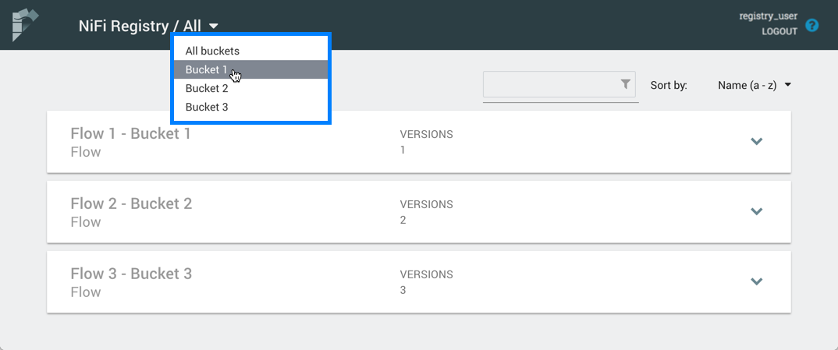
Enterprise Services Centralized security, governance and operations for HDP and HDF
Apache Ambari
“Manage, Maintain & Monitor”
Apache Ranger/ Atlas
“Secure & Govern”
Schema & Flow Registry
“Govern Schema”
Provide Reusable Schemas/flows
Version Management
Format & Ensure Data Quality
FDLC
Installation, patch and upgrade
Configuration Management
Alert & Monitor
Centralized authorization
RBAC & ABAC fine grain authorization
Key management
Audit / Lineage

Slide 8
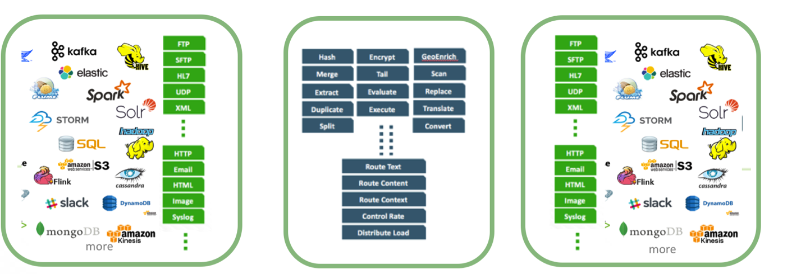
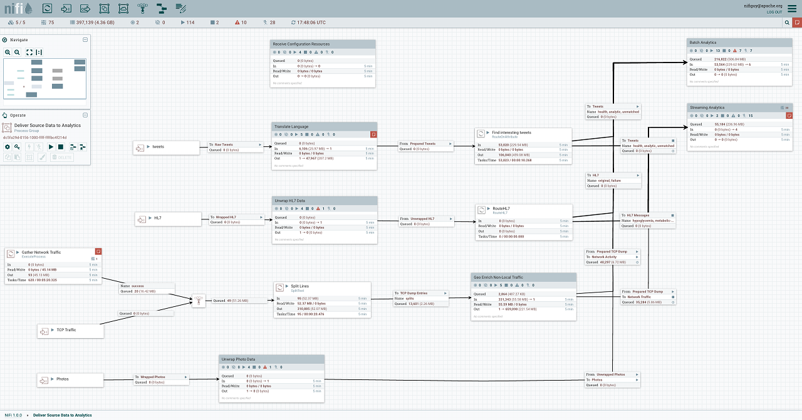
Flow Management Enable easy ingestion, routing, management and delivery of any data anywhere (Edge, cloud, data center) to any downstream system with built in end-to-end security and provenance
Acquire
Process
Deliver
Over 360+ Prebuilt Processors
Easy to build your own
Parse, Enrich & Apply Schema
Filter, Split, Merger & Route
Throttle & Backpressure
Guaranteed Delivery
Full data provenance from acquisition to delivery
Diverse, Non-Traditional Sources
Eco-system integration
Advanced tooling to industrialize flow development (Flow Development Life Cycle)

Slide 9
Hands on!

